Slide 1
Introduction to Technical Writing

Slide 2
What is Technical Writing?
It is a broad term for any written material in …
Science
Engineering
Technology
Medicine

Slide 3
Technically written documents can be categorized as,
Reports, Communication
Operational Manuals
Technical Papers, Magazines, Articles, Books
Patent Documents

Slide 4
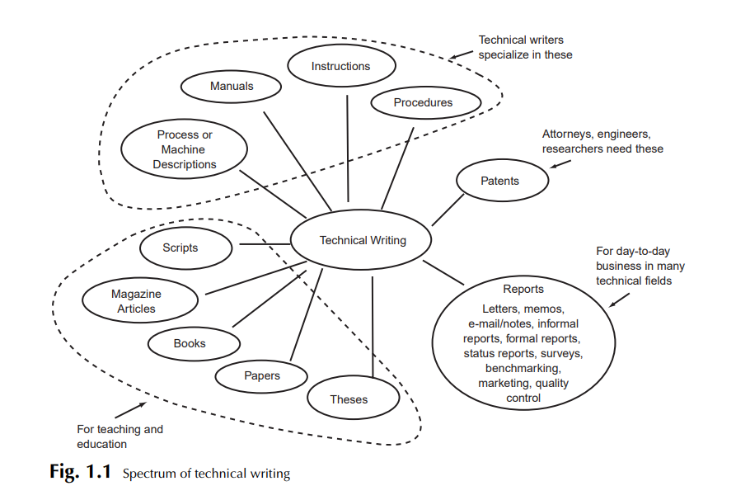

Slide 5
Attributes of Technical Writing
Impersonal
It does not use subjective language, nor does it have any subjective vision
Concise
It is to the point, yet focuses on every detail.
Directed
It is directed to specific audience and readers.
Archival
Written in such a manner that it can be saved, reused and revised.
Cites other Contribution
It includes all other relevant work done by different people of the same field.
Specific style and format
It has a specific style and format, which includes charts, graphs, test results theories.
Pertain to Technical Subject
It speaks for the particular and relevant subject.

Slide 6
The Importance of Technical Writer
In most of the cases, these reports and documents are one’s only form of communication with clients, government agencies, managers, and professionals at other facilities and companies.
The recipient will usually use the report or document to perform a task, make a decision, solve a problem, or acquire information and knowledge.

Slide 7
Common Purposes of Technical Writing
To Inform
To Instruct
To persuade

Slide 8
A technical writer should be good at/with
Subject Knowledge
Research Skills
Knowledge of the conventions of Technical Communication
Writing Skills

Slide 9
Technical Writer- job post SourceCode Private Ltd
Job brief
We are looking for a Technical Writer to produce high-quality documentation that contributes to the overall success of our products. You will join a team of talented tech writers who work collaboratively with developers, quality engineers, product managers, and usability experts to make our products easier to use.
Responsibilities
Work with internal teams to obtain an in-depth understanding of the product and the documentation requirements
Produce high-quality documentation that meets applicable standards and is appropriate for its intended audience
Write easy-to-understand user interface text, online help and developer guides
Create tutorials to help end-users use a variety of applications
Analyze existing and potential content, focusing on reuse and single-sourcing opportunities
Create and maintain the information architecture
Requirements and skills
Proven working experience in technical writing
Ability to deliver high quality documentation paying attention to detail
Ability to quickly grasp complex technical concepts and make them easily understandable in text and pictures
Excellent written skills in English
Strong working knowledge of Microsoft Office
University degree in Computer Science, Engineering or equivalent preferred

